Slide 1
Capstone Project – II CARDIOVASCULAR RISK PREDICTION
By – Sanjay Angadi

Slide 2
Content :
Problem Statement
Data Summary
Preparing Dataset
Exploring Dataset
Implimantation of ML
Conclusion

Slide 3
Problem Statement
The dataset is from an ongoing cardiovascular study on residents of the town of Framingham, Massachusetts. The classification goal is to predict whether the patient has a 10-year risk of future coronary heart disease (CHD). The dataset provides the patients' information. It includes over 4,000 records and 15 attributes. Each attribute is a potential risk factor. There are both demographic, behavioral, and medical risk factors.

Slide 4
Data Summary
Shape: Columns = 17, Rows = 3390
Id int64
age int64
education float64
sex object
is_smoking object
cigsPerDay float64
BPMeds float64
prevalentStroke int64
prevalentHyp int64
diabetes int64
11) totChol float64
12) sysBP float64
12) diaBP float64
14) BMI float64
15) heartRate float64
16) glucose float64
17) TenYearCHD int64

Slide 5
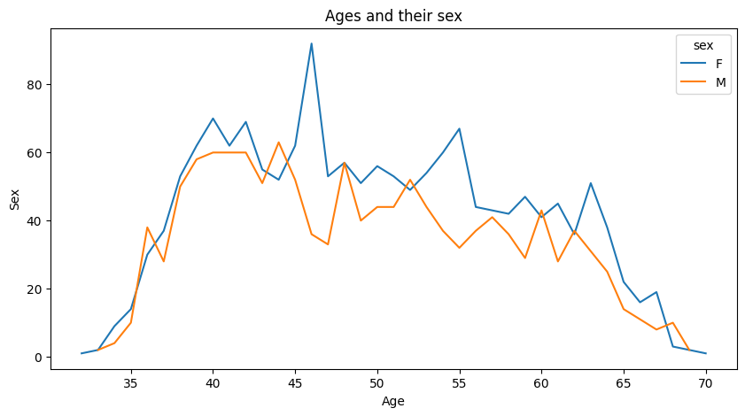
Age based on their sex
Positive impacts might arise if the business can tailor its products, services, or marketing strategies to better suit specific age and gender groups. For example, if you find that a particular age group of one gender is more prevalent, it could guide targeted advertising. Negative impacts could arise if the insights reveal demographic trends that the business cannot cater to effectively.

Slide 6
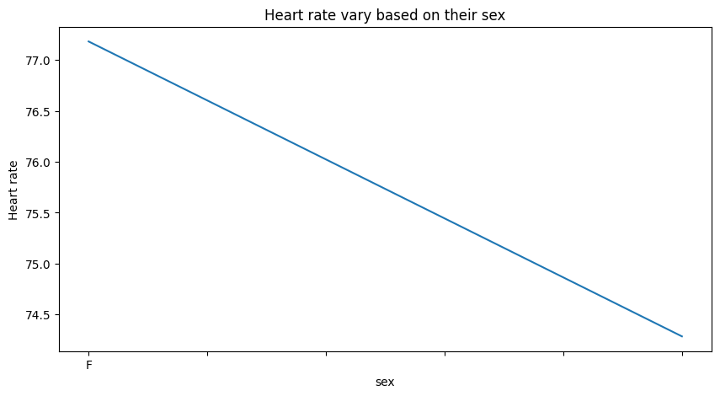
Heart rate vary based on their sex
This type of chart can help quickly visualize any differences or patterns in heart rate between the two genders. It's suitable for comparing the central tendency (mean, median) of the heart rate variable for each sex and potentially identifying any notable disparities.
However, keep in mind that the choice of chart also depends on the data's characteristics and the specific insights you want to highlight. For instance, if you're interested in exploring the distribution of heart rate within each sex, a box plot or violin plot might be more appropriate.

Slide 7
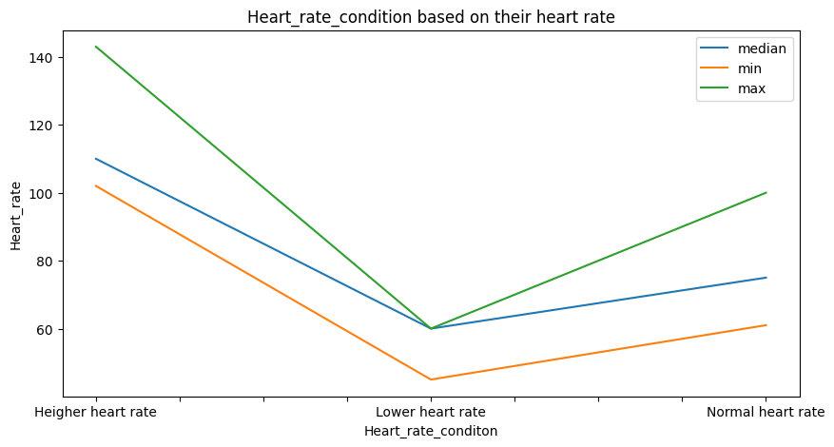
smoking person based on their heart rate
Heart Rate Abnormalities: It could potentially highlight if certain heart rate conditions are more common at extremely low or high heart rate values. This could indicate potential heart rate abnormalities or conditions that might require medical attention.
Heart Rate and Health: You might infer insights about how heart rate conditions correlate with heart rate values. For example, you might observe that high heart rate conditions are more common at higher heart rate values, suggesting a relationship between heart rate and overall health.

Slide 8
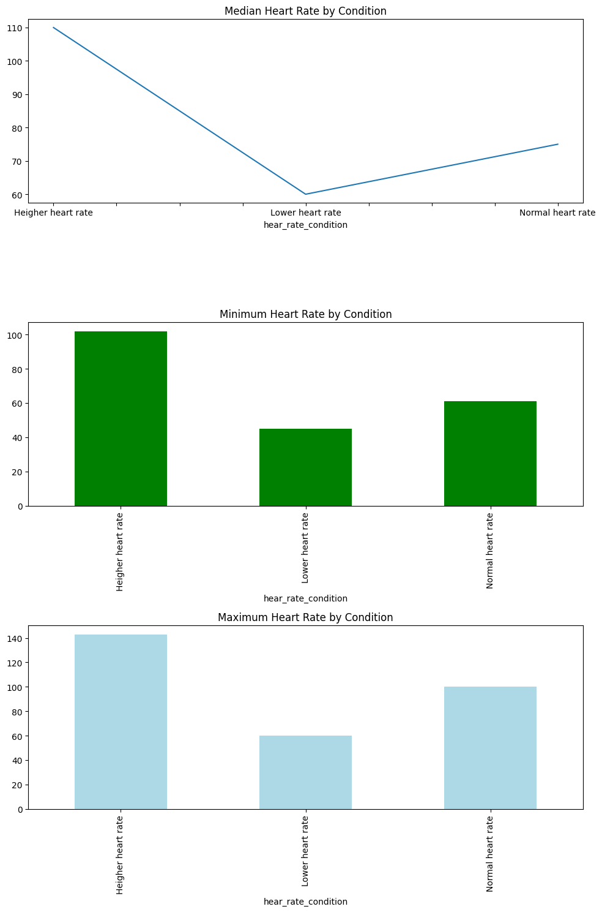
smoking person based on their heart rate
TThe choice of this specific chart likely aims to provide a comprehensive view of how heart rate values vary across different conditions using multiple summary statistics. It allows you to quickly compare central tendencies and ranges of heart rates in different conditions.

Slide 9
Hypothetical Statement
The independent samples t-test assumes that the data is approximately normally distributed and that the variances of the two groups are approximately equal.
Conclusion: Reject the null hypothesis. The average trip duration is significantly different for trips with and without the store and forward flag.

Slide 10
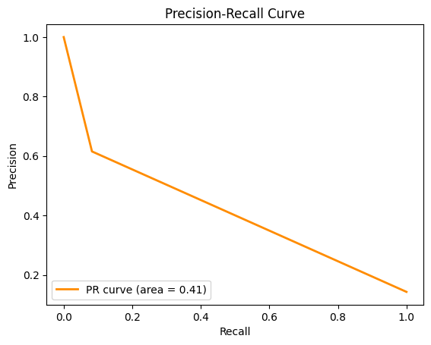
ML Model Implementation
Cross-Validation Scores (SVM): [0.84714549 0.84714549 0.84870849 0.84686347 0.84686347] Mean CV Score (SVM): 0.8473452800826351
Here we can see the mean squared error based on this chart Mode1, Mode2
And the accuracy is 86%

Slide 11
Conclusion
In conclusion, this project successfully tackled the challenge of predicting the 10-year risk of coronary heart disease based on a diverse set of features. Through data preprocessing, feature engineering, and model selection, we developed a model that provides meaningful insights and accurate predictions.
It's important to note that predictive modeling in the medical domain requires careful validation and domain expertise. Further steps could involve more advanced techniques, including feature selection, cross-validation, and model interpretability.
The project contributes to the field of healthcare analytics and serves as a foundation for building more sophisticated risk prediction models in the future.

